Slide 1
1. Restore natural knee function Empowering Kinematic Restoration of the Knee to restore natural Knee function

Slide 2
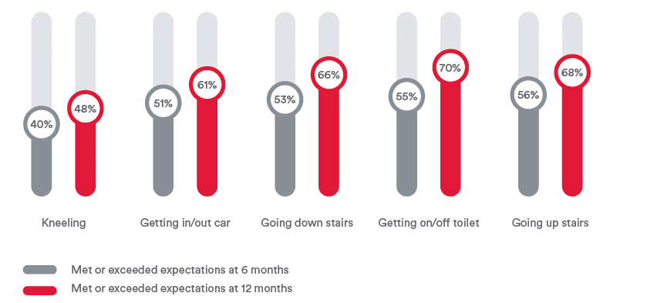
The Challenge
Help you to do better for your patients.
At 6 and 12 months postoperative, ~30% to 60% of patients report limitations in meeting functional expectations, like getting on/off a toilet or walking up/down stairs^{1 *}
80% of TKA patients do not experience a natural joint vs. 42% of THA patients^{51 **}
Pre-op Expectations Met/Exceeds at 6 & 12 months Post-op¹
* Study conducted in USA
** Study conducted in Canada ​
Notes:
Whilst TKA is a very successful procedure, everyone who works in the field understands some of the limitations and challenges. We are trying to restore function to an incredibly complex joint. Whilst the majority of patients are satisfied with their pain relief many suffer from functional issues or a lack of confidence in their joint.
Is this something that resonates with you and your patients?

Slide 3
Kinematic Restoration
Kinematic Restoration is the art and science of restoring knee function.
From pre-op through post-op, from incision to closure—it provides a holistic approach that works in harmony with kinematic and inverse kinematic alignment philosophies
The VELYS™ Robotic-Assisted Solution equips surgeons with real-time insights to optimize implant placement, preserve soft tissue envelope, predict joint stability and work toward returning knee function.^{5-7,42}
ATTUNE™ Knee is verified to work with kinematic alignment techniques within tested boundaries.^{3-6*}
The powerful combination can reduce soft tissue releases to improve function and may accelerate patient recovery.⁷
*Based on in vitro studies.

Slide 4
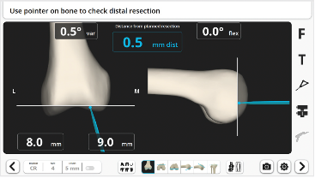
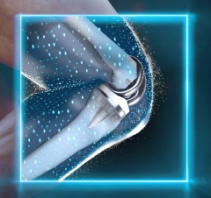
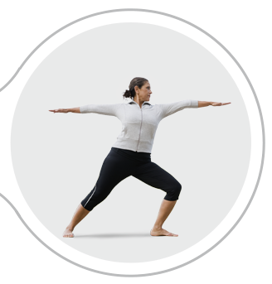
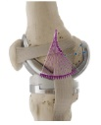
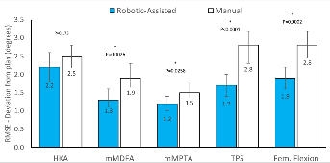
Johnson & Johnson MedTech Knee Platform Solutions
Kinematic Restoration
Surgeon driven landmark acquisition
Surgeons control the 3D surgical plan (e.g. rKA, iKA, MA)
Pre-resection soft tissue balance check
Surgeon controlled, Robotic-Assisted resection
Immediate accuracy verification & ability to adjust the plan
Implantation of Kinematically-advanced ATTUNE Knee
Stability
Satisfaction
Improved Accuracy
Fewer Soft-Tissue Releases
Improved Patient Function & Outcomes
Multiple studies have demonstrated ATTUNE to exhibit smooth roll-back without abrupt change at mid-flexion⁸⁻¹¹
ATTUNE Knee is delivering better patient satisfaction than the class of other knees.^{12¶}
Studies demonstrate
VELYS Robotic-Assisted Solution has improved implant alignment accuracy compared to Manual.^{13,14 †}
The VELYS Robotic-Assisted Solution showed significantly lower incidence of
intentional soft tissue release compared to manual TKA.⁷
After one year of follow-up, patients treated with the VELYS™ Robotic-Assisted Solution showed statistically significant improvements (p<0.05) in their Oxford Knee Score, WOMAC, Forgotten Knee Score, KOOS ADL, Activity Pain, and Range of Motion compared to those treated with the BRAINLAB KNEE3 Navigation System^{15*}
90%
Of patients are feeling better following TKA with ATTUNE Knee.^{1§}
88%
Of patients are satisfied
with the results of their
ATTUNE Knee TKA surgery.^{2¶}
P<0.0001
¶According to the NJR ISR for ATTUNE Cemented, 88% of patients reported satisfaction in responding to the question "How would you describe the results of your operation?
†Product may not be commercially available in all markets. This content may not be used externally in those markets where regulatory approval has not been granted for all the products referenced.
*In a prospective study of 90 TKA patients.
§ According to a Patient Satisfaction PROMS analysis 90% reported improvement in responding to the question "Overall, how are your problems now, compared to before your operation”.
Notes:
We started this journey with the development of the ATTUNE implant system. Subtle changes in geometry have improved the kinematics of the tibia-femoral and patella femoral articulations, moving the needle in patient satisfaction. Unlike any other knee manufacturer - the ATTUNE knee design allows the surgeon to more closely restore the patient's natural bony anatomy, within tested and published boundaries.
The challenge of implementing patient specific alignment strategies is how to accurately plan and make the required variable bones cut.
VELYS Robotic-Assisted Solution provides real time feedback on soft tissue balance through the range of motion.
VELYS Robotic-Assisted Solution puts the surgeon in the driver’s seat. You control the selection of the critical points in the registration, you define and control the surgical plan and predict the balance of the knee prior to committing to making any resections.
you control where the saw goes in the defined cut plane, you adjust the plan seamlessly based on both clinical assessment and the data provided through the procedure.

Slide 5
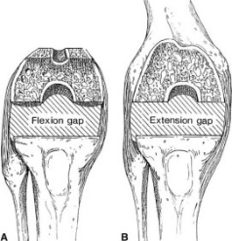
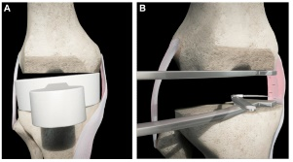
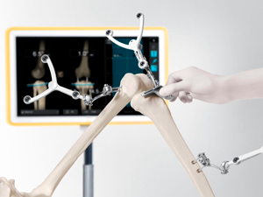
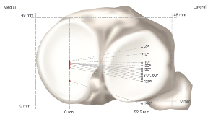
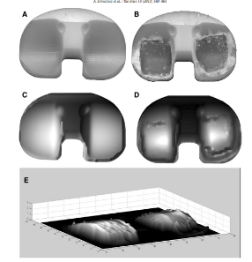
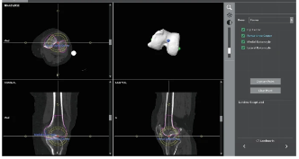
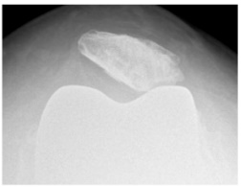
Limitations
How can you do better for your patients?
Implant
Technique
Technology
Research has shown that legacy Designs can contribute to mid-flexion Instability which can lead to a lack of patient confidence in the knee.¹⁶
The natural knee is seen to be very stable medially and roll back laterally, medial instability has been associated with worse outcomes.¹⁷
Patella Femoral tracking can be compromised when performing patient specific techniques.¹⁸
Mechanical alignment is the current gold standard tech, but only 0.1% of patients have neutral femurs and tibias.¹⁹
Mechanical alignment requires soft tissue releases to balance the knee in a high proportion of cases.²⁰
Implants designed and tested under mechanical alignment conditions. Very limited published implant testing under alternative alignment conditions which may influence wear and fixation performance.²¹
Manual instruments have reduced accuracy when implementing patient specific techniques and lack predictive data on balancing.²²
Navigation systems require positioning and pinning of cutting blocks adding additional steps to the procedure.²³
CT based Robotic systems are reliant on technician defined landmark acquisition.²⁴
Notes:
We started this journey with the development of the ATTUNE implant system. Subtle changes in geometry have improved the kinematics of the tibia-femoral and patella femoral articulations, moving the needle in patient satisfaction. Unlike any other knee manufacturer - the ATTUNE knee design allows the surgeon to more closely restore the patient's natural bony anatomy, within tested and published boundaries.
The challenge of implementing patient specific alignment strategies is how to accurately make the required variable bones cut.
VELYS Robotic-Assisted Solution provides real time feedback on soft tissue balance through the range of motion. You can predict the balance of the knee prior to committing to making any resections.
VELYS Robotic-Assisted Solution puts the surgeon in the driver’s seat. You control the selection of the critical points in the registration, you define and control the surgical plan, you control where the saw goes in the defined cut plane, you adjust the plan seamlessly based on both clinical assessment and the data provided through the procedure.

Slide 6
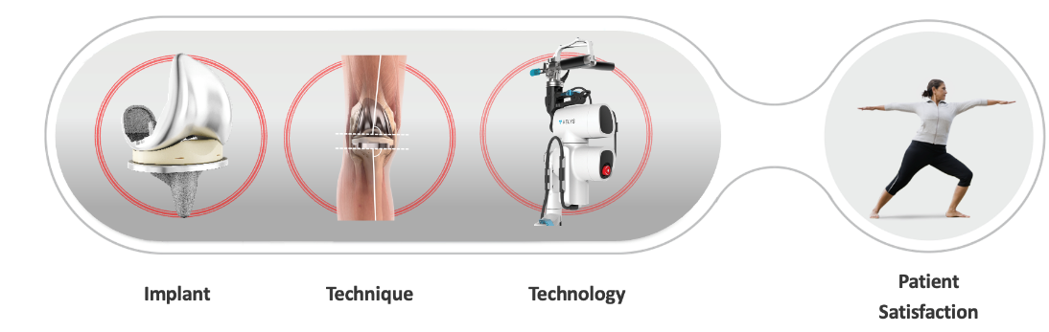
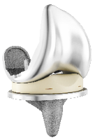

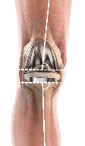
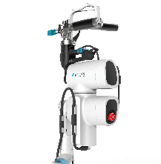
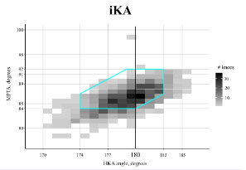
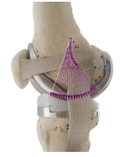
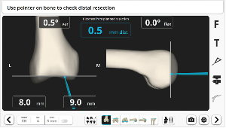
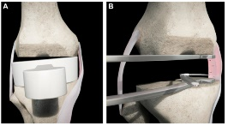
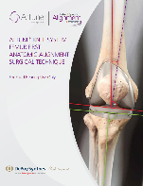
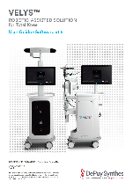
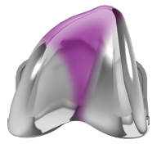
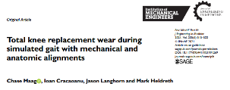
J&J Knee Platform Solutions
Clinically empowering Kinematic Restoration of the Knee to restore natural Knee function
ATTUNE™ Knee System
Implant
Technique
Technology
The ATTUNE GRADIUS™ Curve is the gradually reducing femoral radius designed to provide a smooth transition from stability to mobility through a patient’s range of motion.⁸⁻¹¹
ATTUNE Medial Stabilized Knee System:
Reduces A/P motion without abrupt direction changes
Increases conformity on the medial compartment
Lateral compartment is flatter to encourage natural femoral rollback^{8,11,25,26}
ATTUNE Knee Advanced Patellofemoral Articulation geometry accommodates variations in trochlear orientation required for kinematic philosophies^{27, 43-49}
Alternative alignment techniques such as rKA and iKA are capable of restoring the alignment and joint line obliquity for a high proportion of the population^{28,29}
Alternative alignment techniques such as rKA and iKA reduce the need for soft tissue releases and adjustments.²⁸⁻³⁰
ATTUNE has approved techniques supporting alternative alignment techniques and have published evidence on performance of ATTUNE in alternative alignments.³¹⁻³³
Parameters are easily adjusted through the VELYS Robotic-Assisted Solution planning screen, helping surgeons to personalize alignment and balance relative to soft tissues.^{32, 50*}
VELYS Robotic-Assisted Solution maintains the saw cut plane to help execute precise, reproducible, surgeon-controlled cuts without cutting blocks^{14*}
Surgeons dictate the selection of the critical points and define the 3D surgical plan³²
*Product(s) may not be commercially available in all markets. This content may not be used externally in those markets where regulatory approval has not been granted for all the products referenced.
Notes:
We started this journey with the development of the ATTUNE implant system. Subtle changes in geometry have improved the kinematics of the tibia-femoral and patella femoral articulations, moving the needle in patient satisfaction. Unlike any other knee manufacturer - the ATTUNE knee design allows the surgeon to more closely restore the patient's natural bony anatomy, within tested and published boundaries.
The challenge of implementing patient specific alignment strategies is how to accurately make the required variable bones cut.
VELYS Robotic-Assisted Solution provides real time feedback on soft tissue balance through the range of motion. You can predict the balance of the knee prior to committing to making any resections.
VELYS Robotic-Assisted Solution puts the surgeon in the driver’s seat. You control the selection of the critical points in the registration, you define and control the surgical plan, you control where the saw goes in the defined cut plane, you adjust the plan seamlessly based on both clinical assessment and the data provided through the procedure.

Slide 7
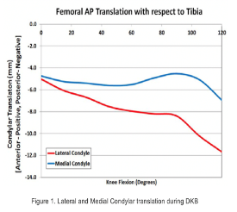
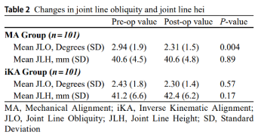
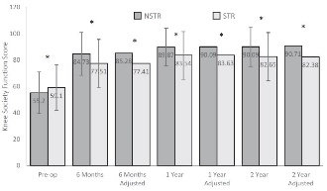

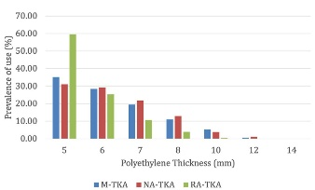
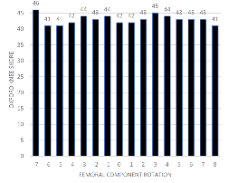
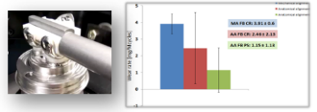
ATTUNE Evidence
Clinically empowering Kinematic Restoration of the Knee to restore natural Knee function
ATTUNE™ Knee System
Implant
Technique
Technology
Multiple studies have demonstrated ATTUNE GRADIUS™ Curve to exhibit smooth roll-back without abrupt change at mid-flexion.⁸⁻¹¹
Simulation has shown that the ATTUNE Medial Stabilized Knee System has lower overall medial condyle motion and does not see the abrupt changes in direction associated with implants based on a multi-radius sagittal geometry.^{25∞}
A Study on the ATTUNE Knee with a patient specific technique found no influence of femoral rotation on PROMs and no patella complications, suggesting the patella femoral design is robust to positioning outside mechanical alignment.³⁴
ATTUNE Knee is delivering better patient satisfaction than the class of other knees.^{12*}
iKA utilizing VELYS Robotic-Assisted Solution allows accurate reconstruction of joint line height & obliquity compared to MA.³⁵
Avoiding soft tissue releases when implanting the ATTUNE™ Knee System has been associated with improved functional outcomes.⁷
Published in vitro testing on the ATTUNE™ Knee Systems showed no increase in wear and equivalent cement fixation under simulated alternative alignment conditions as compared to mechanical alignment. ^{33,36**}
The use of iKA and KA have been associated with either equivalent or improved short term clinical and functional outcomes compared to mechanical alignment.^{37,38}
Studies demonstrate the use of VELYS Robotic-Assisted Solution results in improved implant alignment accuracy compared to manual.^{13,14§}
The VELYS Robotic-Assisted Solution showed significantly lower incidence of intentional soft tissue release compared to manual TKA.⁷
VELYS Robotic-Assisted solution has demonstrated reduced navigation time and improved accuracy compared to Navigation.³⁹⁻⁴¹
After one year of follow-up, patients treated with the VELYS™ Robotic-Assisted Solution showed statistically significant improvements (p<0.05) in their Oxford Knee Score, WOMAC, Forgotten Knee Score, KOOS ADL, Activity Pain, and Range of Motion compared to those treated with the BRAINLAB KNEE3 Navigation System^{15¶}
P<0.0001
90%
88%
Of patients are feeling
better following TKA with
ATTUNE Knee.^{1†}
Of patients are satisfied with the results of their ATTUNE Knee TKA surgery.^{2*}
∞ Shows the results of ATTUNE CR, ATTUNE MS, Persona MC, and Triathlon CS in both CR and CS applications. In CR application, medially, both the ATTUNE CR and MS implant constructs demonstrated minimal Femoral A-P translation, which stayed constant during most of the flexion. Both constructs experienced posterior femoral translation (rollback). The Persona MC experienced similar medial A-P translation as that of the ATTUNE CR and MS. However the A-P direction of translation reversed at about 25 degrees and 60 degrees of knee flexion. CS application, medially the ATTUNE MS construct experienced the least amount of total A-P translation, the ATTUNE MS, Persona MC and Triathlon CS (in that order). Conclusion: Demonstrates differences between the LP motion patterns, ligament force contributions and their strains for all simulated implant constructs in CR and CS application. The CS application, without PCL, the femur could slide anteriorly with flexion if the insert does not provide desired constraint to the anterior translation. Results: Demonstrated the effect of the size mis-matched Femurs in the Persona MC constructs. Trends indicated that the Femur-insert articulation for the smaller Femur size may offer less medial A-P stability that is achieved the the larger sized Femur. The subsets of the results were normalized to their starting point at full extension and compared within designs. *According to the NJR ISR for ATTUNE Cemented, 88% of patients reported satisfaction in responding to the question "How would you describe the results of your operation?” †According to a Patient Satisfaction PROMS analysis 90% reported improvement in responding to the question "Overall, how are your problems now, compared to before your operation"
**In vitro testing of components positioned with a simulated HKA of 3° Varus and a tibial joint line of 5° Varus
¶In a prospective study of 90 TKA patients.
§ Product may not be commercially available in all markets. This content may not be used externally in those markets where regulatory approval has not been granted for all the products referenced.
Notes:
We started this journey with the development of the ATTUNE implant system. Subtle changes in geometry have improved the kinematics of the tibia-femoral and patella femoral articulations, moving the needle in patient satisfaction. Unlike any other knee manufacturer - the ATTUNE knee design allows the surgeon to more closely restore the patient's natural bony anatomy, within tested and published boundaries.
The challenge of implementing patient specific alignment strategies is how to accurately make the required variable bones cut.
VELYS Robotic-Assisted Solution provides real time feedback on soft tissue balance through the range of motion. You can predict the balance of the knee prior to committing to making any resections.
VELYS Robotic-Assisted Solution puts the surgeon in the driver’s seat. You control the selection of the critical points in the registration, you define and control the surgical plan, you control where the saw goes in the defined cut plane, you adjust the plan seamlessly based on both clinical assessment and the data provided through the procedure.

Slide 8
References
Tippett S. R. et al: Collecting Data with Palm Technology: Comparing Preoperative Expectations and Postoperative Satisfaction in ​Patients Undergoing Total Knee Arthroplasty, JBJS: December 1, 2010 - Volume 92 - Issue Supplement_2 - p 59-67 doi: 10.2106/JBJS.J.00827 Scientific Articles. (M_EM_DPS_JRKN_217451.1)
National Joint Registry for England, Wales, Northern Ireland and the Isle of Man. Implant Summary Report for DePuy ATTUNE Cemented. Web Site. www.ATTUNEevidence.com . Accessed 26 February 2025 (M_EM_DPS_JRKN_217461.1)
Johnson and Johnson MedTech. Vivo Knee Simulator Wear Test – Anatomical Alignment Attune TKA. 2017. Windchill #103384220. (M_US_DPS_JRKN_390282)
Johnson and Johnson MedTech. Attune Fixed Bearing: Intraoperative ROM Simulation and Pull-Off Test with Lipid and Marrow. 2017. Windchill #103397037.
Johnson and Johnson MedTech. Attune porous tibia micromotion with anatomic and mechanical alignment. 2021. Windchill #103839160. (M_US_DPS_JRKN_390282)(C_EM_DPS_JRKN_390281.EN)
Johnson and Johnson MedTech. Anatomic Alignment Surgical Technique and Patellar Tracking Validation Report. 2017. Windchill #103335944. (C_EM_DPS_JRKN_390281.EN) (M_US_DPS_JRKN_390282)
Spitzer A, Gorab R, Barrett W, et al. Robotic-assisted total knee arthroplasty reduces soft-tissue releases which improves functional outcomes: A retrospective study. Knee. 2024;49:52-61.(C_EM_DPS_JRKN_390281.EN)(M_US_DPS_DGSR_328959.1)
List E, Schutz R, Angst M, Ellenberger L, Datwyler K, Ferguson SJ. Videofluoroscopic Evaluation of the Influence of a Gradually Reducing Femoral Radius on Joint Kinematics During Daily Activities in Total Knee Arthroplasty, Journal of Arthroplasty, 2020; 35 (10), 3010-3030 (M_EM_DPS_JRKN_217508.1) (C_EM_DPS_JRKN_311748.EN)
Pfitzner T, Moewis P, Stein P, et al. Modifications of femoral component design in multi-radius total knee arthroplasty lead to higher lateral posterior femoro-tibial translation. Knee Surg Sports Traumatol Arthrosc. 2018;26(6):1645-1655. doi:10.1007_s00167-017-4622-7 (M_EM_DPS_JRKN_217508.1)
Khasian M, Sharma A, Fehring TK, Griffin WL, Mason JB, Komistek RD. Kinematic Performance of Gradually Variable Radius Posterior-Stabilized Primary TKA During Various Activities: An In Vivo Study Using Fluoroscopy. J Arthroplasty. 2020;35(4):1101-1108. doi:10.1016_j.arth.2019.10.053 (M_EM_DPS_JRKN_217508.1)
Takagi H, Asai S, Sato A, Maekawa M, Kawashima H, Kanzaki K. Case series report of navigation-based in vivo knee kinematics in total knee arthroplasty with a gradually reducing femoral radius design. Ann Med Surg (Lond). 2017;17:33-37. Published 2017 Mar 29. doi:10.1016_j.amsu.2017.03.032 (M_EM_DPS_JRKN_217508.1)(C_EM_DPS_JRKN_311748.EN)
National Joint Registry for England, Wales, Northern Ireland and the Isle of Man. Implant Summary Report for DePuy ATTUNE Cemented. Web Site. www.ATTUNEevidence.com . Accessed 26 February 2025 (M_EM_DPS_JRKN_217461.1)
Alton TB, Severson EP, Ford MC, Lesko J, Leslie IJ (2025) VELYS robotic-assisted total knee arthroplasty: Enhanced accuracy and comparable early outcomes versus manual instrumentation during adoption. J Exp Orthop 12:e70163 (M_US_DPS_DGSR_105103.1)
Doan, G.W., et al., Image-Free Robotic-Assisted Total Knee Arthroplasty Improves Implant Alignment Accuracy: A Cadaveric Study. J Arthroplasty, 2022. 37(4): p. 795-801.
Clatworthy M. VELYS Robotic-Assisted Solution (VELYS Robotic-Assisted Solution) Vs. BrainLab Knee3 TKA - Early Outcomes Study. NZOA & AOA Combined Annual Scientific Meeting; 2022; Christchurch (M_US_DPS_DGSR_328488)
Clary, C.W., et al., The influence of total knee arthroplasty geometry on mid-flexion stability: an experimental and finite element study. J Biomech, 2013. 46(7): p. 1351-7
Tsukiyama H, Kuriyama S, Kobayashi M, et al. Medial rather than lateral knee instability correlates with inferior patient satisfaction and knee function after total knee arthroplasty. Knee.2017;24(6): 1478-1484. doi:10.1016_j.knee.2017.09.004
Lustig, S., E. Servien, and C. Batailler, How to optimize patellar tracking in knee arthroplasty? Orthop Traumatol Surg Res, 2023. 109(1S): p. 103458
Almaawi AM, Hutt JRB, Masse V, Lavigne M, Vendittoli PA (2017) The Impact of Mechanical and Restricted Kinematic Alignment on Knee Anatomy in Total Knee Arthroplasty. J Arthroplasty 32:2133-2140
Oussedik S, Abdel MP, Victor J, Pagnano MW, Haddad FS (2020) Alignment in total knee arthroplasty. Bone Joint J 102-B:276-279
Srivastava A, Lee GY, Steklov N, Colwell CW, Jr., Ezzet KA, D'Lima DD. Effect of tibial component varus on wear in total knee arthroplasty. 5 presented at The Knee; 2012, 2012
Koutp, A., et al., Accuracy of Conventional Instrumentation is Dependent on Alignment Philosophy Using the Identical Surgical Technique in Total Knee Arthroplasty. J Knee Surg, 2024. 37(1): p. 20-25
DePuy Synthes, PATIENT SPECIFIC ALIGNMENT: TIBIA FIRST SURGICAL TECHNIQUE A BALANCED APPROACH USING BRAINLAB KNEE3 NAVIGATION.2019
Stryker,MAKO TKA™ Surgical Guide. 2016
DePuy Synthes. Forward dynamics modeling analysis: multi-patient verification report. 2021.Windchill. SEA103845908 (M_US_DPS_JRKN_311748)
Mane AM, Komistek RD, Heldreth MA. The soft tissue harmony with the knee motion in Cruciate Retaining Arthroplasty, ORS-2021. (C_EM_DPS_JRKN_311748.EN)
Mane, A., et al., Does Femoral Flange Design Influence Patellafemoral Mechanics in Patient Specific Alignment in ISTA 2023 (C_EM_DPS_JRKN_314345.EN)
Almaawi AM, Hutt JRB, Masse V, Lavigne M, Vendittoli PA (2017) The Impact of Mechanical and Restricted Kinematic Alignment on Knee Anatomy in Total Knee Arthroplasty. J Arthroplasty 32:2133-2140
Winnock de Grave P, Luyckx T, Van Criekinge T, Muller JH, Ollivier B, Van Eecke E, et al. (2023) Inverse kinematic alignment accommodates native coronal knee alignment better in comparison to adjusted mechanical alignment and restricted kinematic alignment. Knee Surg Sports Traumatol Arthrosc 31:3765-3774
Oussedik S, Abdel MP, Victor J, Pagnano MW, Haddad FS (2020) Alignment in total knee arthroplasty. Bone Joint J 102-B:276-279

Slide 9
References
DePuy Synthes, ATTUNE® KNEE SYSTEM FEMUR FIRST ANATOMIC ALIGNMENT SURGICAL TECHNIQUE. 2017
Johnson & Johnson and its affiliates. VELYS™ Robotic-Assisted Solution for Total Knee. Surgical Technique, Femur First Approach (November 2024). Windchill Report 103744585 Rev J
Maag C, Cracaoanu I, Langhorn J, Heldreth M (2021) Total knee replacement wear during simulated gait with mechanical and anatomic alignments. Proc Inst Mech Eng H 235:515-52 (M_EM_ORT_JRKN_396989)
Murgier J, Clatworthy M. Variable rotation of the femur does not affect outcome with patient specific alignment navigated balanced TKA. Knee Surg Sports Traumatol Arthrosc. 2022;30(2):517-526. https://pubmed.ncbi.nlm.nih.gov/32783080/. Accessed March 3, 2025. (M_EM_ORT_JRKN_396987)
Shichman I, Hadad A, Brandstetter AS, Ashkenazi I, Warschwaski Y, Gold A, et al. (2024) Better restoration of joint line obliquity in tibia first restricted kinematic alignment versus mechanical alignment TKA. Archives of Orthopaedic and Trauma Surgery;10.1007/s00402-024-05551-8 (M_EM_ORT_DGSR_396986)
Maag C, Peckenpaugh E, Metcalfe A, Langhorn J, Heldreth M. INFLUENCE OF ALIGNMENT-SPECIFIC PHYSIOLOGICAL LOADING FOLLOWING INTRAOPERATIVE LIPID/MARROW INFILTRATION AND INTRAOPERATIVE MOTIONS UPON TIBIAL IMPLANT FIXATION. Orthopaedic Proceedings 2020;102-B(SUPP_1):32 (M_EM_ORT_JRKN_396989)
Elbuluk AM, Jerabek S, Suhardi J, Sculco P, Ast M, Vigdorchik JM (2022) Head-to-Head Comparison of Kinematic Alignment versus Mechanical Alignment for Total Knee Arthroplasty. J Arthroplasty;10.1016/j.arth.2022.01.052
Winnock de Grave P, Kellens J, Tampere T, Vermue H, Luyckx T, Claeys K (2022) Clinical outcomes in TKA are enhanced by both robotic assistance and patient specific alignment: a comparative trial in 120 patients. Arch Orthop Trauma Surg;10.1007/s00402-022-04636-6
Ho JPY, Jagota I, Twiggs J, Liu DW (2024) Robotic-Assisted Total Knee Arthroplasty Results in Shorter Navigation Working Time With Similar Clinical Outcomes Compared to Computer-Navigated Total Knee Arthroplasty. J Arthroplasty;10.1016/j.arth.2024.09.026 (M_EM_ORT_DGSR_396988)
Bourgeault-Gagnon Y, Salmon LJ, Lyons MC (2024) Robotic-Assisted Total Knee Arthroplasty Improves Accuracy and Reproducibility of the Polyethylene Insert Thickness Compared to Manual Instrumentation or Navigation: A Retrospective Cohort Study. Arthroplasty Today 30 (M_EM_ORT_DGSR_396988)
Doan GW, Van Avery A, Courtis RP, Leslie IJ, Hoeffel D, Clary C. Improvement in Primary Resection Accuracy with Image Free Robotic Assisted Total Knee Arthroplasty Compared to Computer Assisted Surgery (CAS). THE 21ST ANNUAL MEETING OF THE INTERNATIONAL SOCIETY FOR COMPUTER ASSISTED ORTHOPAEDIC SURGERY; 2022; Brest, France (M_EM_ORT_DGSR_396988)
Huang P, Cross M, Gupta A et al. Early Clinical and Economic Outcomes for the VELYS Robotic-Assisted Solution Compared with Manual Instrumentation for Total Knee Arthroplasty. J Knee Surg 2024;37:864–872. (C_EM_DPS_JRKN_390281.EN)
Clary, C.W., Wright, A.P., Komosa, M.C., Maletsky, L.P. (2012b). The effect of patella medialization on patellofemoral kinematics after total knee replacement. 18th Congress of the European Society of Biomechanics (ESB); 29: 1262. (C_EM_DPS_JRKN_314345.EN)
Fitzpatrick CK, Clary CW, Rullkoetter PJ. The role of patient, surgical, and implant design variation in total knee replacement performance. Journal of Biomechanics. 2012;45:2092-2102. (C_EM_DPS_JRKN_314345.EN)
Barrett D, Wright, A., ATTUNE Knee System: GLIDERIGHT Articulation Whitepaper. (C_EM_DPS_JRKN_314345.EN)
Deacy J, Fitzpatrick C. Comparison of Natural and Unresurfaced Patellofemoral Mechanics. ORS 2012. Poster #1062. (C_EM_DPS_JRKN_314345.EN)
Clary CW, Fitzpatrick CK, Maletsky LP, Rullkoetter PJ, Probabilistic Modeling of Fem Component Overhang. ORS Poster #1988. 2012. (C_EM_DPS_JRKN_314345.EN)
Fitzpatrick C, Baldwin M. Identifying Alignment Parameters Affecting Implanted Patellofemoral Mechanics. J. of Orthopedic Research. JULY 2012. 1167-75. (C_EM_DPS_JRKN_314345.EN)
Johnson & Johnson MedTech (DePuy Synthes) IFU - ATTUNE Total Knee System - Fixed Bearing and Rotating Platform Bearing Knee. 0902-60-062_elFU Rev. A. (C_EM_DPS_JRKN_314345.EN)
Johnson & Johnson and its affiliates. VELYS™ Robotic-Assisted Solution for Unicompartmental Knee Surgical Technique Guide. Rev B. May 27, 2025. Windchill #501965473.
Collins M, Lavigne M, Girard J, Vendittoli PA (2012) Joint perception after hip or knee replacement surgery. Orthop Traumatol Surg Res 98:275-280
Important information: Prior to use, refer to the instructions for use supplied with the device(s) for indications, contraindications, side effects, warnings and precautions.
The third-party trademarks used herein are the trademarks of their respective owners.
© Johnson & Johnson and its affiliates 2025. C_M_EM_ORT_DGSR_399044.EN

